Slide 1

ML 24/25-09 Semantic Similarity Analysis of Textual Data
Nishta Muraleedharan - 1520040

Slide 2
CONTENTS
Objective
Introduction
System Design
Modes of Operation
Best Embedding Model and Similarity Metric
Python App for Visualization
Results
Limitation
Future Works
Conclusion
References

Slide 3
OBJECTIVE
Design and implement an application in C# that can effectively compute the semantic similarity between various levels of textual data, including words, phrases, and documents using OpenAI's embedding model and export the results in CSV format that can be further used for visualization
Analyze embedding vectors by plotting their scalar values to gain deeper insights into their structure and representation.

Slide 4
Introduction
Importance of Semantic Similarity Analysis
Crucial for text classification, recommendation systems, question answering, and automated document analysis.
Evolution of Text Representation
Count Based Embeddings
Eg. Bag of Words, TF-IDF
Static Word Embeddings
Eg. Word2Vec, GloVe
Contextualized Embeddings
Eg. BERT, OpenAI's Ada
Keyword-based, lacks semantic understanding.
Mapping words into a vector space but lack contextual adaptation.
Adjust dynamically based on surrounding context, capturing deeper semantic relationships.

Slide 5
Introduction
Real-World Applications:
Search engines (Google, Bing) – query intent recognition.
E-commerce platforms (Amazon, eBay) – product ranking and recommendations.
Healthcare and legal sectors – document retrieval and case law matching.
Job portals (LinkedIn, Indeed) – resume-to-job matching based on skills.
Why OpenAI's GPT Embeddings?
Consistent Vector Dimensions: Works effectively across varying text lengths, from single words to entire documents.
High Semantic Accuracy: Captures contextual nuances better than static models.
Scalability & Adaptability: Trained on large, diverse datasets, making it generalizable across multiple domains.
Optimized for Similarity Tasks: Unlike models like BERT, which are designed for sentence-level tasks, OpenAI embeddings excel in broader semantic comparisons.

Slide 6
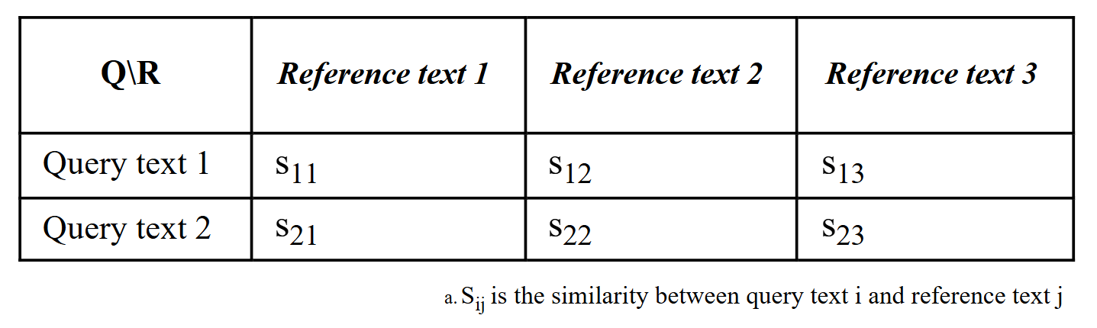
System Design
Modes of Operation
To facilitate comparison across all levels of textual data, there are three modes of operation:
Compare words or phrases with words or phrases
Compare documents with words or phrases
Compare documents with documents
Expected CSV Output

Slide 7
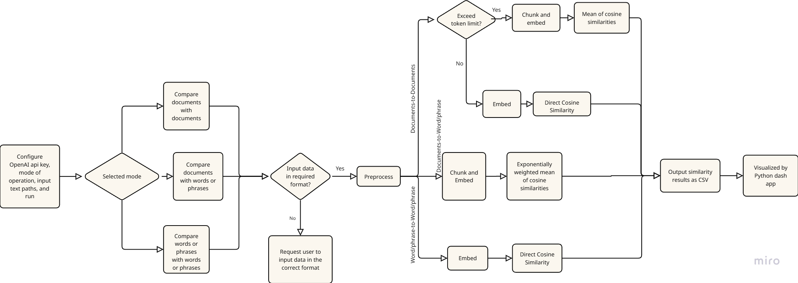
System Design
Application Flow Diagram

Slide 8
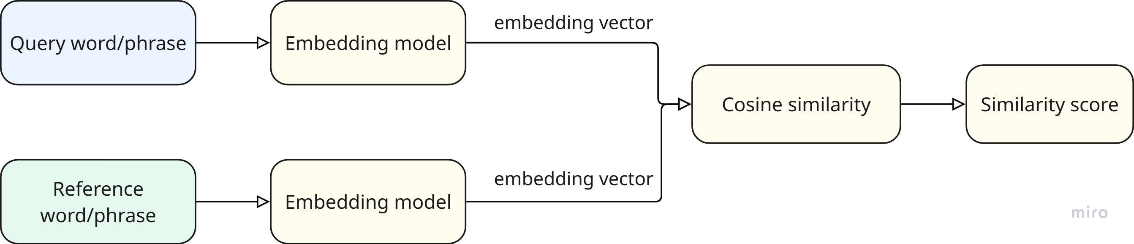
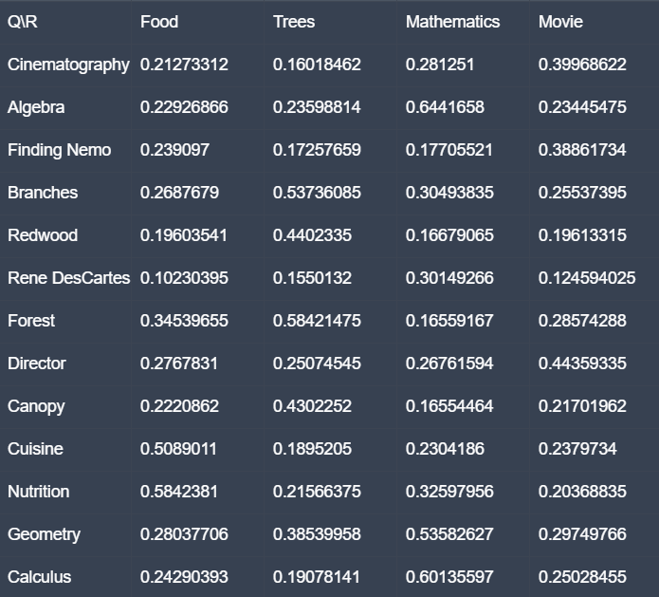
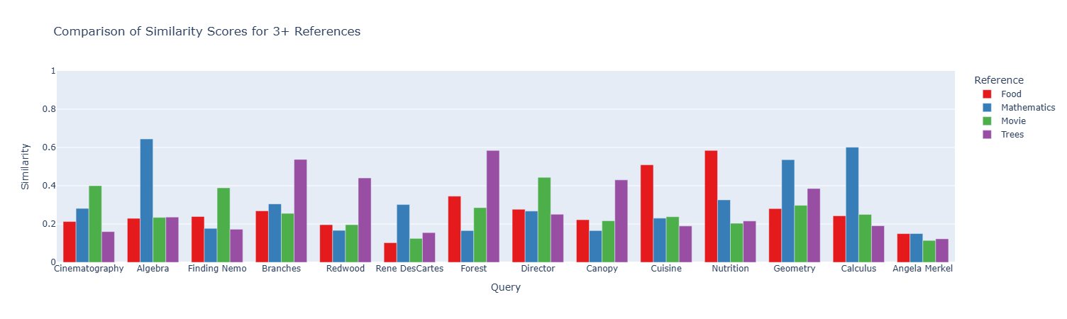
Mode – Compare Words/Phrases with Words/Phrases
This mode can be used to analyse seemantic relationships between words/phrases and to classify them into specific domains
Computation of semantic similarity between words and phrases
Output CSV from application
Output visualization

Slide 9
Mode – Compare Documents with Words/Phrases
Goal - Find the document which has the most relevant information about the word or phrase
Direct Comparison between embedding of the word/phrase and the document doesnot give accurate information while searching for smaller sections in a big document
Inputs docs:
1. Football(only about football) | 1000 word essay about football. Highly relevant
2.Global warming(1 whole para about football) | 1175 word essay with around 147 words useful information about football and rest about global warming. This simulates documents where relevant information is present but overall context is unmatching
3.Sports(2 mention of football) | 1000 word essay on sports. only contexual alignment and metion of word football two times. No useful information about football
4.Sports(0 mention of football) | 1000 word essay on sports. only contexual alignment . No useful information about football
5.Leisure activities(0 mentions of football) | 1000 word essay on leisure activities. Only slight contexual alignment. No useful information about football
6.Global warming(0 mention of football) | 1000 word essay on global warming. No contexual alignment or no useful information about football
Expected result | 1>2>3>5>6 and noteable difference between 1,2 and 3,4,5
Comparison using single embedding for whole document

Slide 10
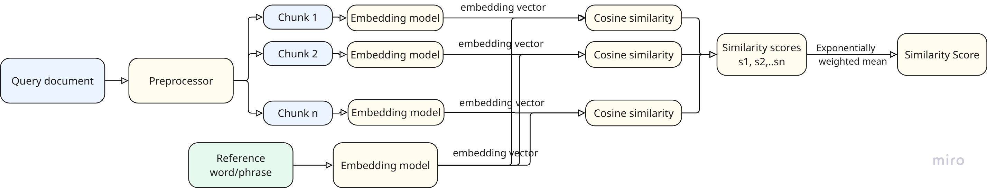
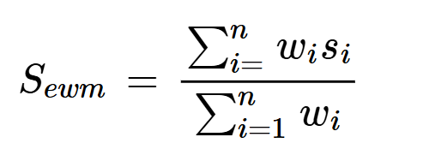
Mode – Compare Documents with Words/Phrases
Proposed solution: Chunking and taking exponentially weighted mean of similarities to giver higher weight for chunks with more relevant data to improve differentiation. Chunk size is kept as 300 words (average paragraph length in English language). Exponentially weighted mean is given by the following equation,
where:
S_{ewm} represents the exponentially weighted similarity,
n is the total number of chunks,
s_{i} denotes individual similarity scores,
w_{i} = e^{βsi} is the weight that assigns exponentially increasing values to higher similarity scores,
β is a tunable parameter that controls the bias toward higher similarity values.

Slide 11
Mode – Compare Documents with Words/Phrases
Testing in real world example
Inputs docs:
1. Multicultural Experiences | 32 page paper on cultural diversity. A round 8 pages talks extensively about impacts of cultural diversity on an individual level
2. Team work in a multicultural context | 5 page paper on team work. Does not talk about impact on individuals but only on the team
Expected output: | 1 > 2
Result after taking exponentially weighted mean of similarities​ shows better differentiation and rightly indicated that document 1 and 2 are of interest
Before taking exponentially weighted mean of similarities no differentiation
After taking exponentially weighted mean of similarities correctly detects relevant content in document 1

Slide 12
Mode – Compare Documents with Documents​
Goal – Identify documents that are similar in overall content and context. Using a single embedding per document effectively captures the general semantic meaning, allowing for efficient similarity comparisons.
This approach follows a similar method as word/phrase-to-word/phrase comparison. Only for large documents exceeding the token limit, the document is divided into chunks, and the mean of the embeddings is computed to generate a single representative vector. This ensures efficient and scalable similarity analysis while preserving the overall semantic meaning of the document.
Best OpenAI embedding model and similarity metric
The OpenAI embedding models - text-embedding-ada-002, text-embedding-3-small, and text-embedding-3-large were compared. Among these, text-embedding-3-large was found to be the most effective for capturing semantic relationships.
For similarity metrics, cosine similarity, dot product, Euclidean distance, and Jaccard similarity were evaluated.
Cosine similarity was chosen as it is independent of vector magnitude and performed best in distinguishing relevant documents.

Slide 13
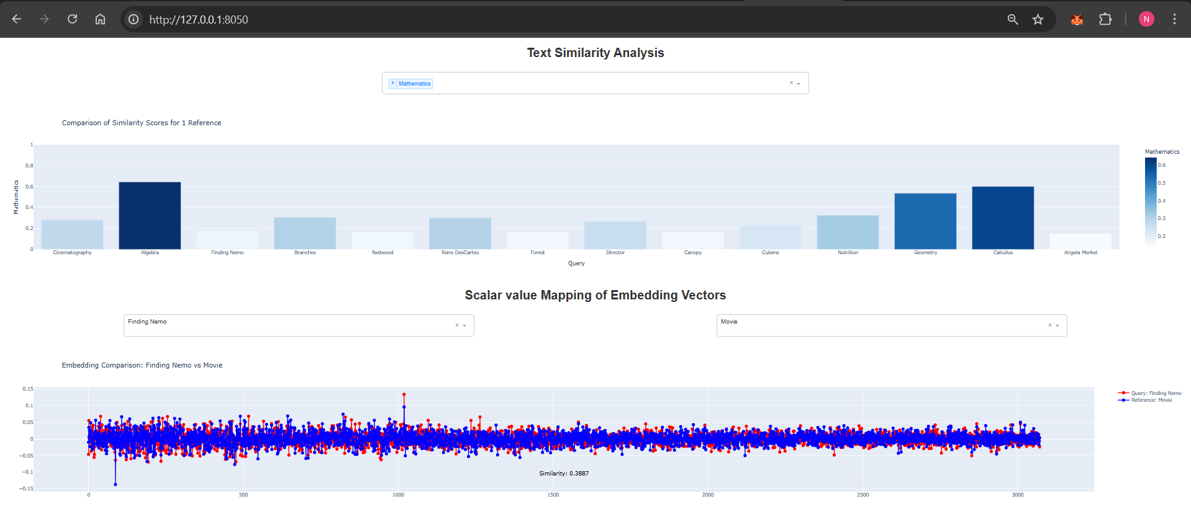
Python app for visualization
Sample view of the visualization app using python (plotly – dash application)

Slide 14
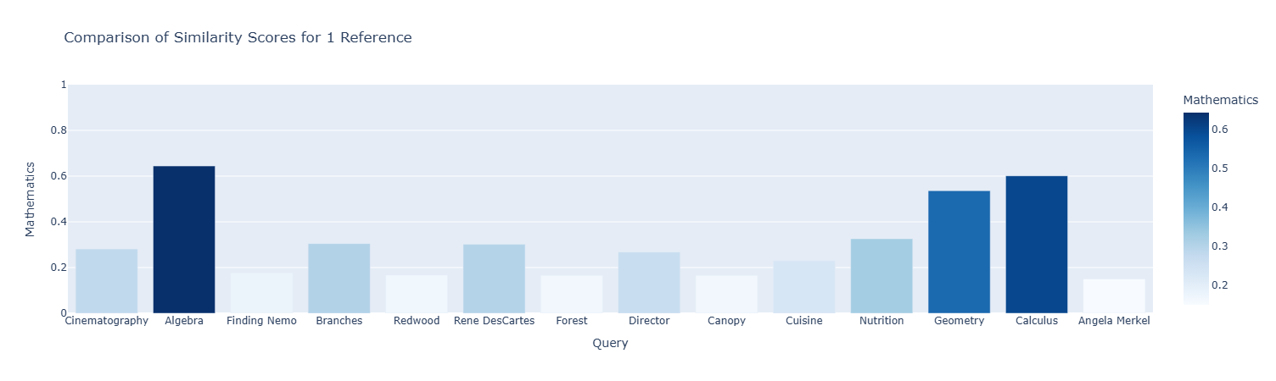
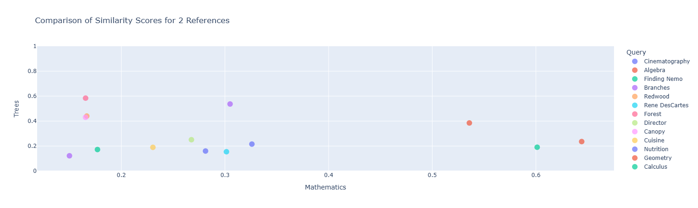
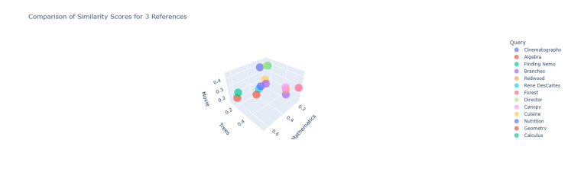
Results
Best OpenAI embedding model: text-embedding-3-large
Best similarity metric: Cosine similarity
Chunking and using exponentially weighted mean of similarities allows fine grained comparison of documents
Implemented similarity visualization using python with different modes of viewing
Visualization using bar graph when there is only one reference
Visualization using scatter plot when there are two references
Visualization using scatter plot when there are three references
Visualization using scatter plot when there are two references

Slide 15
Limitations
Increased processing time and compute power – As documents are processed in smaller chunks now, the computational costs and processing time have increased, and may slow down the application, particularly for large-scale comparisons of large documents.
Future Work
Optimizing Performance – Implement multithreading to speed up embedding generation and similarity calculations, reducing processing time for large datasets.
Domain-Specific Customization – The application can be adapted for specific use cases in different fields by customizing the preprocessing steps, and fine-tuning the β value in the exponentially weighted mean function to optimize similarity scoring based on domain-specific requirements. There is opportunity to integrate semantic chunking that can improve accuracy and optimize the chunking process.
Integration with Additional Models – Extend the application to support newer embedding models, for enhanced flexibility and to improve performance.

Slide 16
Conclusion
Successfully developed a C# application to compute and analyze semantic similarity across different textual levels.
Implemented OpenAI embeddings and advanced similarity metrics to enhance accuracy.
Integrated an interactive Python Dash-based visualization tool for better interpretability.
Demonstrated the effectiveness of exponentially weighted mean similarity for fine-grained document differentiation.
The project lays the foundation for more efficient and adaptable text similarity analysis in various domains.

Slide 17
References
H. Cao, “Recent advances in text embedding: A comprehensive review of top-performing methods on the MTEB benchmark,” arXiv preprint, arXiv:2406.01607, 2024. Available: https://arxiv.org/abs/2406.01607.
S. Zhang, Y. Liang, M. Gong, D. Jiang, and N. Duan, “Multi-view document representation learning for open-domain dense retrieval,” arXiv preprint, vol. 2203.08372, 2022. Available: https://arxiv.org/abs/2203.08372.

Slide 18
THANK YOU !

